Slide 1
Automation Framework
2025

Slide 2
Automation Framework
An automation framework is a set of practices, tools, and guidelines used to streamline the process of creating and executing automated test cases.
The framework provides a structured and efficient environment for testing activities, making them more manageable, reusable, and scalable.
The framework defines a set of rules or best practices which user can follow in a systematic way to achieve the desired results.
Core Components
Test Data Management: Handling input/output data for tests.
Libraries & Utilities: Reusable functions for common actions (e.g., login, navigation).
Reporting Mechanism: Generates logs and reports for test results.
Configuration Files: Store environment details, browser settings, and execution parameters.
Integration Support: Works with CI/CD pipelines for continuous testing

Slide 3
Automation Framework
Advantages of using framework:
Saves time and maintain Schedule: Automation testing is faster in execution and definitely help to maintain overall project timeline
Reusability of code: Create one time and execute multiple times with less or no maintenance
Easy reporting: It generates automatic reports after test execution
Easy for compatibility testing: It enables parallel execution in combination of different OS and browser environments
Low-cost maintenance: It is cheaper compared to manual testing in a long run
Reliability: Automated testing is more reliable as less manual intervention is required
Repetitive multiple execution for same set of test cases: It is mostly used for regression testing, supports execution of repeated test cases
Minimal manual intervention: Test scripts can be run unattended
Maximum coverage. It helps to increase overall test coverage

Slide 4
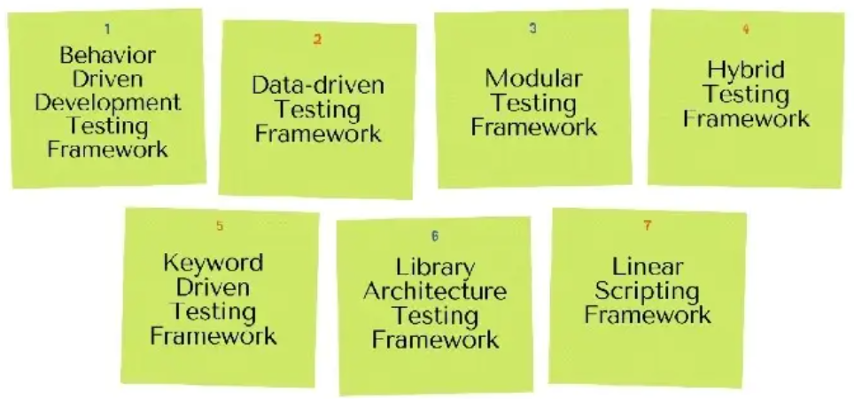
Types of Automation Frameworks

Slide 5
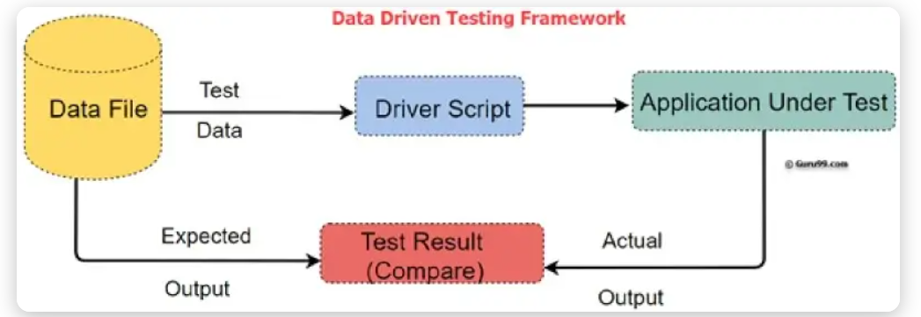
Data-driven framework
Data-driven framework
This framework separates the test data from the test logic. A single test script can be executed multiple times with different sets of data, which are stored in external files (e.g., CSV, Excel).
Example:
To test a login page with multiple users, you can use a single script that reads a list of usernames and passwords from an Excel file.
Username Password Expected Result
testuser1 correct1 Success
testuser2 correct2 Success
baduser wrongpass Failure

Slide 6
Data-driven framework
Pros:
Changes made to the test scripts do not affect the test data.
It supports multiple data sets.
Saves time by running more tests.
Since the data is kept separate from the test script, a variety of test scenarios can be performed simply by changing the test data in the external data file.
Data input / output and expected results are stored as easy-to-maintain text records in the database.
Cons:
High setup time for both Test Scripts and Test Data.
Bug-fixing may be difficult due to the lack of exposure the tester has on a programming language.
Testers must have excellent technical knowledge.
It is necessary to have experienced automation testers to design the framework.

Slide 7
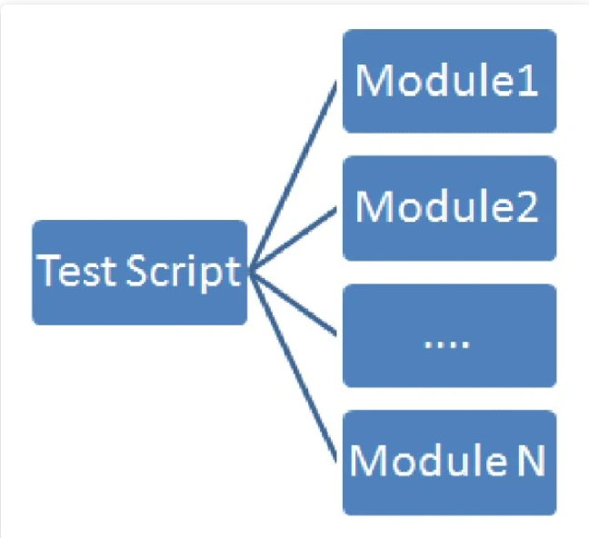
Modular-Testing framework
Modular-Testing framework
This framework divides the application under test into smaller, independent modules. Testers create individual test scripts for each module, and a master script can then call these modules to build larger test cases.
Example:
For an e-commerce site, the application can be broken down into modules like Login, Search, and Checkout.
A Login module script contains steps to log in.
A Search module script contains steps to search for a product.
A Checkout module script contains steps to complete a purchase.
A test case for "purchasing a product" would call the Login, Search, and Checkout modules in sequence.

Slide 8
Modular-Testing framework
Pros:
It ensures the division of scripts that leads to easier maintenance and scalability.
Reusable.
Separate test scripts can be written.
Changes made to one module have little or no impact on the other modules.
Cons:
Requires technical knowledge to set up the framework.
It takes more time to analyze and identify reusable flows.
When updating the code or script, the fact that the test script has embedded test data can be a problem.
Since data is still hard coded in the script, the same test case cannot be run for multiple data values without changing data after each run.

Slide 9
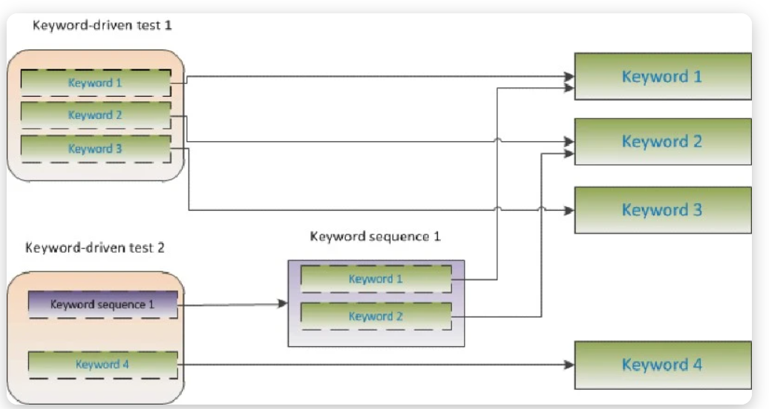
Keyword-driven framework
Keyword-driven framework
This framework uses keywords to represent actions (e.g., click, type, verify) and stores them in external data tables. A driver script interprets these keywords and executes the corresponding code.
Example:
A test case for a login page might be stored in a spreadsheet like this:
Action Object Data
OpenBrowser Chrome
EnterText usernameField testuser
EnterText passwordField pass123
ClickButton loginButton

Slide 10
Keyword-driven framework
Pros:
It is not necessary to be an expert to write test scripts. Once the libraries are ready, it becomes very easy to write the actual test script steps in excel sheets.
Keywords are reused across multiple test cases. High reusability can be achieved by re-using across multiple test cases.
Offers greater flexibility when it comes to maintenance and fixing of bugs
Cons:
High development time. Takes time to build and stabilize the framework and to create the function libraries.
Due to the flexibility the test cases become longer and more complex.
High automation knowledge required.
The initial cost of setting up the framework is high. The benefits of this can only be realized if the application is considerably big and the test scripts are to be maintained for quite a few years

Slide 11
Behavior-driven development (BDD) framework
Behavior-driven development (BDD) framework
Uses natural language (Gherkin syntax) to define test scenarios. This framework focuses on the application's behavior from the end-user's perspective, using a simple, natural language syntax called Gherkin. It promotes collaboration among developers, testers, and business stakeholders.
Example:
Using a tool like Cucumber, a test scenario is written in a .feature file.
Feature: Login functionality
Scenario: Successful login with valid credentials
Given the user is on the login page
When the user enters a valid username and password
And the user clicks the login button
Then the user should be redirected to the dashboard

Slide 12
Behavior-driven development (BDD) framework
Pros:
Improved Collaboration by using a shared human readable language.
Clear Requirements written
Early defect detection by focusing on behavior and catching issues before development begins
Keeps the focus on business value and user outcomes rather than technical details
Supports Agile & CI/CD
Cons:
Requires time and effort to establish tools (e.g., Cucumber, SpecFlow) and practices
Teams must learn Gherkin syntax and adapt to writing scenarios in a structured way
Requires discipline in writing scenarios.
For simple applications, BDD may add unnecessary complexity compared to traditional testing

Slide 13
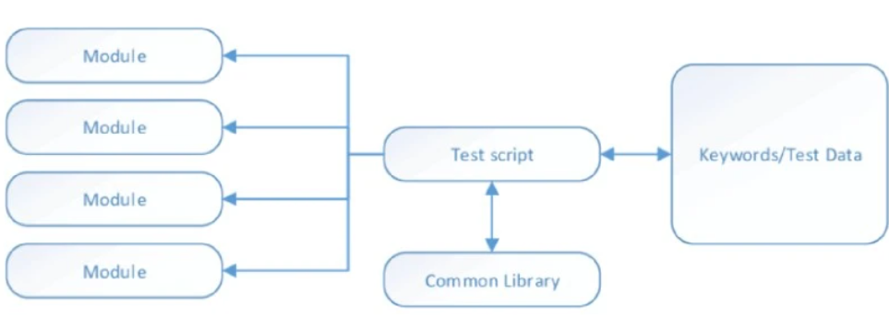
Hybrid Automation Framework
The Hybrid Testing Framework is a combination of two or more frameworks. This combination is created to take advantage of the benefits of the different frameworks and mitigate their weaknesses.

Slide 14
Hybrid Automation Framework
Pros:
Leverages the advantages of the different related frameworks.
It provides flexibility: framework independent of system or environment under test.
It allows reusing test cases and library functions.
It improves testing efficiency due to higher code reusability.
Cons:
It requires technical knowledge and experience to build a hybrid framework from scratch.
Increased Complexity.

Slide 15
Linear Framework
Linear framework (Record and Playback)
This is the most basic and straightforward framework.
Testers record their actions as they interact with the application, and the tool generates a sequential test script that can be played back.
Pros: Requires no coding skills and is very fast to set up for simple & quick tests.
Cons: Not reusable or scalable, and scripts are brittle and difficult to maintain when the application changes.
Example: Using Selenium IDE to record login steps for a web application

Slide 16
Library Architecture Testing Framework
This testing framework identifies tasks that are similar within the test script. Then, testers put together these similar tasks into different groups based on their functions. Once the functions are grouped, these groups will be stored in a library. The test scripts reuse these libraries to create new test cases.
The Library Architecture Testing Framework is useful when the application has similar functionalities in different parts of the application.

Slide 17
Standard POM (Page Object Model) Maven project structure ideal for clean, scalable test automation.
POMFramework/
├── pom.xml # Maven configuration file
├── testng.xml # TestNG suite configuration
├── src/
│ ├── main/
│ │ └── java/
│ │ ├── pages/ # Page Object classes
│ │ │ ├── LoginPage.java
│ │ │ ├── HomePage.java
│ │ │ └── ProfilePage.java
│ │ ├── utils/ # Utility classes
│ │ │ ├── DriverFactory.java
│ │ │ ├── ConfigReader.java
│ │ │ └── TestUtils.java
│ │ └── base/ # Base classes
│ │ └── BasePage.java
│ └── test/
│ └── java/
│ ├── tests/ # Test classes
│ │ ├── LoginTest.java
│ │ ├── HomeTest.java
│ │ └── ProfileTest.java
│ └── base/ # Base test setup
│ └── BaseTest.java
└── resources/
├── config.properties # Environment configs (URL, credentials, browser)
├── log4j.properties # Logging configuration
└── testdata/ # Test data files
├── loginData.xlsx
└── profileData.csv
pom.xml → Defines dependencies (Selenium, TestNG, Apache POI, ExtentReports, etc.) and plugins.
testng.xml → Controls which tests run, grouping, parallel execution, etc.
pages/ → Each application page has its own class with locators + methods (Page Object Model).
utils/ → Helpers like driver management, config readers, wait utilities, reporting.
base/ → Common setup/teardown logic for pages and tests.
tests/ → Test classes that use page objects to perform workflows.
resources/ → External files (config, logging, test data).

Slide 18
Key Components of a framework
1. Test scripts
These are the core of the framework, containing the automated instructions that interact with the application under test (AUT). They are written in a programming language (e.g., Python, Java, JavaScript) and specify the actions to be performed and the validations to be made.
2. Test data management
This component handles the data used during test execution. A robust framework allows test data to be separated from the test scripts, supporting different scenarios and enabling data-driven testing. Data can be stored in various formats, such as CSV files, databases, or JSON files.
3. Test execution engine
This is the "powerhouse" that runs the test scripts. A sophisticated engine can manage the test run, handle data, and execute tests across multiple environments and configurations. It often supports advanced features like parallel execution and cross-browser testing.
4. Reusable libraries and utilities
These are collections of functions and common code snippets that can be reused across different test scripts. They promote code reuse, minimize maintenance efforts, and help maintain consistency throughout the test suite.
5. Object repository
The object repository stores the location details (e.g., ID, CSS selector, XPath) of all UI elements that test scripts interact with. This separation of UI elements from the test script logic makes the framework more maintainable. If an element's locator changes, the update only needs to be made in one central location.
6. Reporting and logging
This component provides clear, comprehensive reports and logs after test execution. It details which tests passed or failed, captures screenshots for failures, and includes execution logs for effective debugging. Good reporting makes test results understandable for both technical and non-technical stakeholders.
7. Environment management
This feature allows for easy configuration of test execution settings depending on the target environment (e.g., QA, staging, production). It manages specific settings such as URLs, database connections, and user credentials.
8. Continuous Integration/Continuous Deployment (CI/CD) integration
A well-designed framework integrates seamlessly with CI/CD tools (e.g., Jenkins, GitLab CI/CD). This allows automated tests to run automatically whenever code is committed or deployed, ensuring continuous testing and faster feedback.
9. Error handling and recovery
This mechanism defines how the framework responds to unexpected events during test execution. It can include logic for managing exceptions, retrying failed tests, and gracefully handling timeouts.
10. Version control
The framework's code, including all test scripts, data, and configuration files, should be managed using a version control system like Git. This supports team collaboration, tracks changes, and allows the team to roll back to previous versions if needed

